Slide 1




Helping great products reach more people, more easily
Foodservice Delta
Belfast
Introducing our business
February 2019
Notes:
In this presentation you find the following sections:
Introduction
Our values, purpose and history
Corporate Responsibility
Business segments
Financial overview

Slide 2
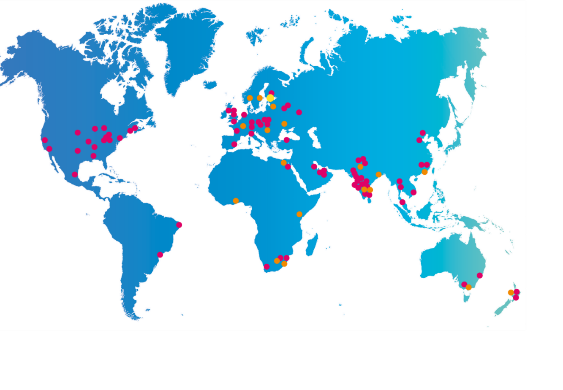
We operate globally and act locally
Manufacturing unit
Sales unit
Head office
34
17,600
€2.9bn
78
24
operating
countries
employees
net sales
manufacturing
units
sales offices

Slide 3
We are building a sustainable future
Our corporate responsibility agenda includes the most relevant topics from the business and the stakeholders’ point of view.
Packaging we make
We provide our customers with safe, fit-for-purpose and environmentally optimal packaging.
Our supply chain
We work to enhance environmental sustainability, social responsibility and ethical business practices in our supply chain.
Our manufacturing operations
We continuously work to reduce the negative environmental impacts of our operations.
People
We value our people and want to offer them equal opportunities for professional growth.
More about our Corporate Responsibility report at www.huhtamaki.com/responsibility

Slide 4
Ecological benefits of cartonboard
A real and functional circular economy
Forests represent significant carbon reservoirs that are bound in the cartonboard*.
Made from wood, an organic, renewable resource, from sustainably managed forests in Europe.
Cartonboard will become nature again and leaves no scars in the environment.
Cartonboard has the highest recycling rate of all packaging materials.
End consumers value the truly functioning circular economy.
*The biogenic CO₂ sequestration of the forests almost equals the CO₂ emission of cartonboard production.

Slide 5
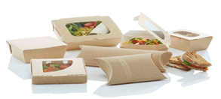
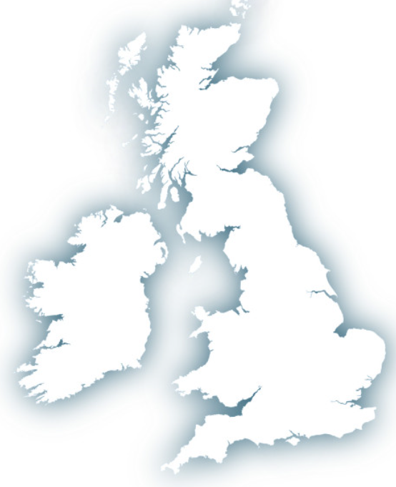
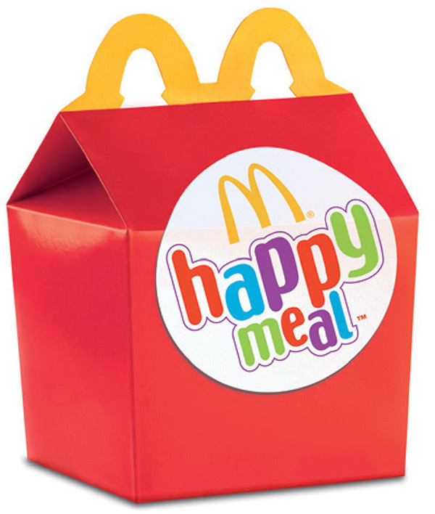

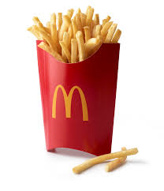
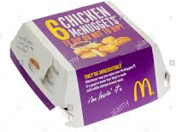
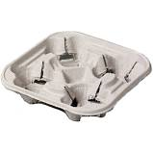
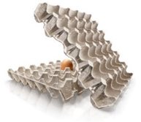
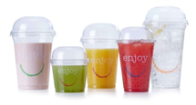
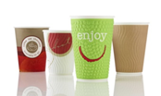
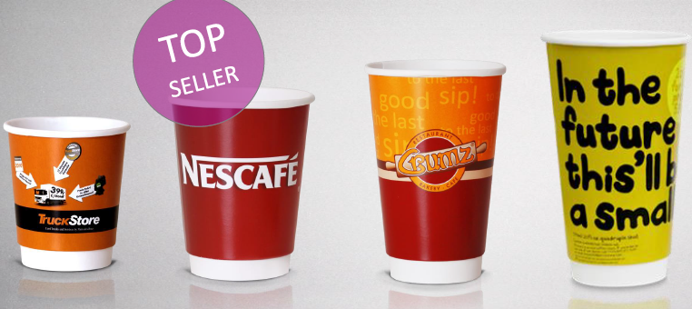
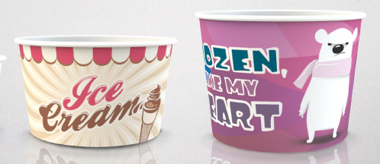
Huhtamaki Foodservice (UK & Ireland)
BLACKBURN
Fluted corrugated
food packaging
BELFAST & ANTRIM
Folding carton packaging
Paper Wraps & Straws
LURGAN
Waste conversion process.
Fibre pulp packaging – cup carriers;
GOSPORT
Paper hot & cold cups
CupPrint Ennis
Small run carton & cups
Compostable vegware cups
Digital print options

Slide 6
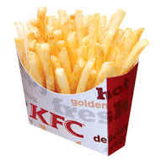
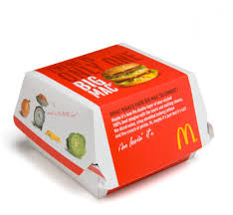
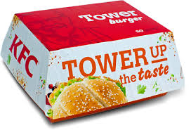
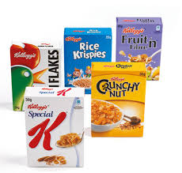
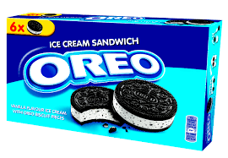
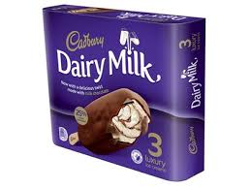
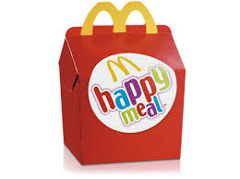
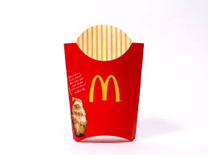
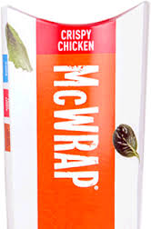
Huhtamaki FS Delta - Belfast
Folding carton leadership in Retail & QSR sectors.
Key Strategic Partnership, strengthening our relationship:
Partnering with brand owners across the food retail sector.
C.15 years supplying KFC & C.20 years supplying McDonald’s across Europe.
Bespoke product range until now.
State-of-the-art production assets provides competitive
strength in Consumer Goods carton sector.
- Other key customers include Kellogg’s Froneri, Pladis, and McCains.

Slide 7
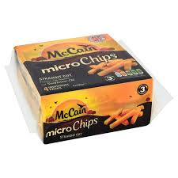
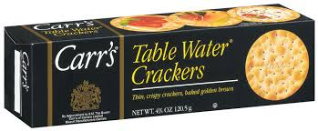
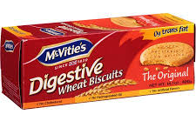

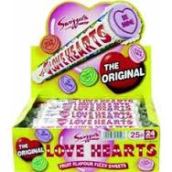
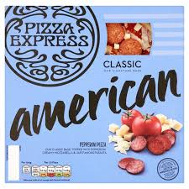
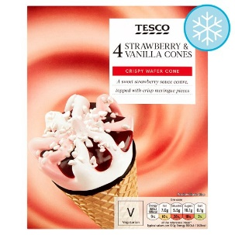
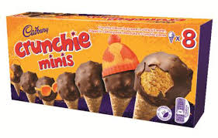
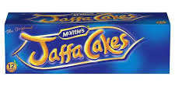
Food Retail & QSR partners
Huhtamaki ownership from May 2016
Benchmark production investments
Rotary HD flexographic printing in Belfast and Gliwice
Rotary die-cutting for ultra-high volume QSR
Sheet-fed Offset printing in standard and VLF formats
In-line sustainable grease barriers for QSR packs
Multiple finishing lines, including 2.4Bn clamshells pa capability
Automated materials handling and packing
2017 conversion of 30,000+ tonnes for QSR sector + 25,000 tonnes for retail food sector customers
35 years experience supplying brand owners across Europe
Strategic folding carton partner with long-term supply partnerships
Unique combined paper/board products and design capabilities
Affiliated product design partner: P4CK Ltd
Strictly confidential

Slide 8
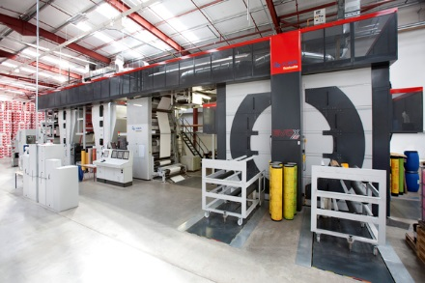
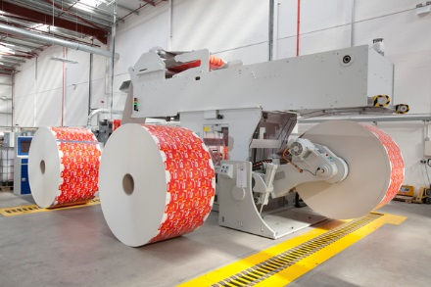
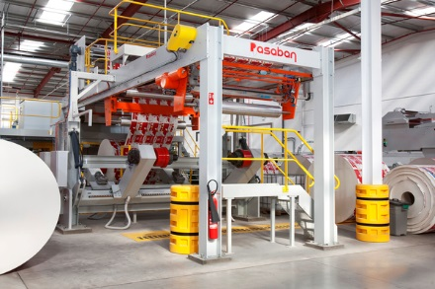
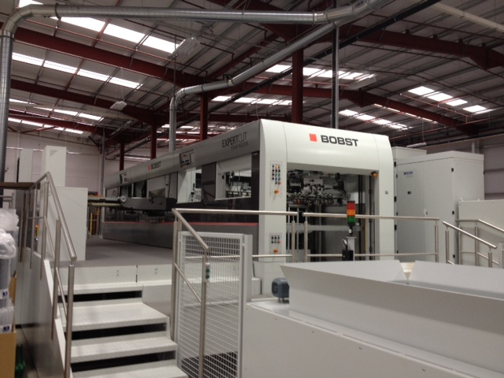
Belfast: Benchmark capability
10 Colour flexo CI
Rotary die-cutting
Integrated sheeting
Large format platens
Notes:
CURRENT SITE CAPABILITIES ARE
Flexographic and lithographic printing
Conversion by flatbed or rotary die cutting,
Gluing (multi-point, in-line and clam shell)
Specialising in food products but with a growing range of non-food products.
Now moving into
The flexographic printing and conversion of wax coated paper to form wraps for direct food contact.
Production of paper straws.

